Slide 1


ECOFEED: INTELLIGENT FOOD DONATION AND WASTE RECYCLING SYSTEM
Presented By
NANTHINI S (2303811710422101)
NAVEENA R(2303811710422104)
PADMA HASSANI N P (2303811710422111)
PRADEEPA B (2303811710422116)
Under the Guidance of
Mrs Valli Priyadharshini K M.E (Ph D)
ASSISTANT PROFESSOR,
DEPT OF CSE,
KRCT.

Slide 2

CONTENTS
PROBLEM IDENTIFICATION
ABSTRACT
OBJECTIVES AND SCOPE OF THE PROJECT
LITERATURE SURVEY
EXISTING SYSTEM
PROPOSED SYSTEM
  ARCHITECTURE DIAGRAM OF PROPOSED SYSTEM
  MODULE DESCRIPTION.
HARDWARE AND SOFTWARE REQUIREMENTS
UI PROTOTYPE SCREENS
IMPLEMENTATION DETAILS/CODE SNIPPETS
TEST CASES/EXPERIMENTAL ANALYSIS
OUTPUT SCREENSHOT
CONCLUSION
REFERENCES
PRODUCTION PUBLICATION PROOF

Slide 3
PROBLEM IDENTIFICATION
Every day, restaurants, hotels, hostels, and event organizers generate a large amount of surplus food that is often discarded despite being safe for consumption.
At the same time, many NGOs and shelters face difficulties in providing sufficient meals to underprivileged communities.
There is no efficient platform that instantly connects food donors with nearby NGOs for timely food collection.
As a result, edible food expires before it can reach the people who need it.
Vegetable waste and spoiled food are commonly dumped in landfills, causing methane emissions and environmental pollution.
These organic wastes can instead be converted into renewable energy through biogas production.

Slide 4
ABSTRACT
EcoFeed is an intelligent mobile application designed to reduce food waste while supporting hunger relief and sustainable waste management.
The platform connects food donors such as restaurants, hotels, hostels, and event organizers with nearby NGOs using GPS-based location matching using GPS location matching logic.
Donors upload surplus food details, including quantity, location, and expiry time.
Food that is no longer suitable for consumption is automatically redirected to registered biogas or composting partners using Smart Expiry based algorithm.
This dual-purpose approach creates a circular ecosystem where edible food feeds people and organic waste generates renewable energy.

Slide 5
OBJECTIVES
Develop a mobile application that connects food donors with NGOs through location-based matching.
Reduce food wastage through efficient food donation and collection.
Prioritize food donations based on expiry dates to minimize spoilage.
Improve transparency through donation tracking and status updates.
Redirect expired food and suitable organic waste to biogas plants for renewable energy production.
Promote environmental sustainability by reducing landfill waste and encouraging resource recycling.

Slide 6
SCOPE OF THE PROJECT
The application serves restaurants, hotels, hostels, supermarkets, caterers, NGOs, shelters, and biogas producers.
It supports efficient food redistribution within local communities using location-based matching.
The platform can be expanded to cities, districts, and state-level food distribution networks.
Future versions can integrate AI-based prediction and IoT-enabled smart waste monitoring.

Slide 7
EXISTING SYSTEM
Food donation is mainly managed through phone calls and social media
This manual process is time-consuming and lacks proper coordination.
There is no centralized platform to connect food donors with nearby NGOs.
This often results in delayed pickups and increased food wastage.
Existing systems do not prioritize food based on its expiry time.
As a result, edible food may spoil before it reaches beneficiaries.
GPS-based matching is not effectively used to identify the nearest recipient.
This increases travel distance, transportation cost, and delivery time.
Organic food waste is usually disposed of in landfills instead of being recycled.
Very few systems connect food waste with biogas or composting facilities.

Slide 8
LIMITATIONS OF EXISTING SYSTEM
Delayed communication between donors and NGOs often causes surplus food to spoil before it reaches the intended beneficiaries.
Existing systems do not prioritize food based on its expiry time, resulting in inefficient distribution and increased food wastage.
The absence of GPS-based nearest-location matching increases travel distance, transportation costs, and food collection time.
Donation records are maintained manually, making it difficult to track food collection, delivery status, and overall transparency.

Slide 9
PROPOSED SYSTEM
EcoFeed provides a unified platform that connects food donors, NGOs, and biogas partners in real time.
Donors can upload surplus food details, including quantity, expiry time, and GPS location.
The application categorizes food into edible and non-edible types.
Edible food is assigned to nearby NGOs, while organic waste is redirected to biogas plants.
NGOs receive instant notifications and can request food immediately.
Biogas partners can schedule pickup for vegetable waste and spoiled food.

Slide 10
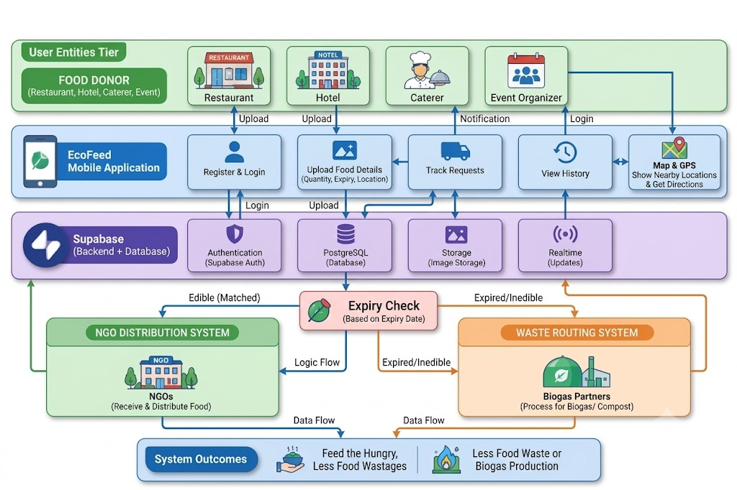
ARCHITECTURE DIAGRAM OF PROPOSED SYSTEM

Slide 11
ADVANTAGES OF PROPOSED SYSTEM
Reduces food wastage by connecting donors with NGOs in real time.
Ensures quick food distribution through location-based matching.
Prioritizes food according to expiry time, reducing spoilage.
Improves transparency through donation tracking.
Converts organic waste into renewable biogas and organic fertilizer.
Supports sustainable development and a circular economy.
Helps NGOs access available food donations easily.
Encourages responsible food donation and waste management.
Reduces the amount of organic waste sent to landfills.
Promotes efficient resource utilization and environmental protection.

Slide 12
MODULE DESCRIPTION
1. User Authentication & Role Management
  Secures registration and login for three distinct user roles: Food Donor, NGO, and Biogas Plant.
  Directs each authenticated user strictly to their role-specific dashboard and navigation paths.
2. Food Donor Module
  Allows donors to list surplus food with key details like quantity, food type, location, and expiry date.
  Tracks the live status of listed donations from creation to pickup completion.
3. Smart Expiry & Automated Waste Routing
  Checks food expiration dates automatically against the real-time system date.
  Routes fresh, unexpired food to the NGO feed and automatically diverts expired food to the Biogas feed.

Slide 13
MODULE DESCRIPTION
4. Beneficiary Operations (NGO & Biogas)
  Enables NGOs and Biogas plants to view available listings and claim batches for collection.
  Provides a one-tap phone calling feature to coordinate instant pickup logistics with donors.
5. Ratings & Feedback System
  Allows beneficiaries to rate completed pickups using an interactive 5-star review system.
  Calculates and updates the donor's overall trust rating and public profile score.
6. Real-Time Notification Engine
  Delivers targeted status alerts whenever a donation is claimed, collected, or reviewed.
  Uses a local tracking mechanism to prevent duplicate pop-up banners on the device.

Slide 14
MODULE DESCRIPTION
7. User Profile Management
  Enables users to update contact details, organization names, and text-based addresses.
  Compresses profile photos directly on the device for fast upload and reliable cloud storage.
8. UI/UX & Adaptive Theming
  Supports high-contrast Material 3 light and dark themes for clear readability across all screens.
  Features smooth page transitions and a custom adaptive launcher icon tailored for Android devices.

Slide 15
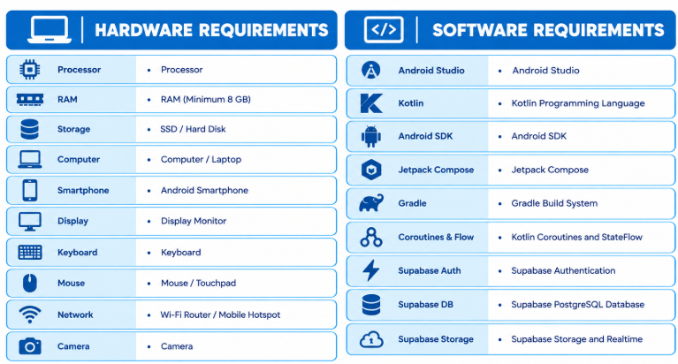
HARDWARE AND SOFTWARE

Slide 16
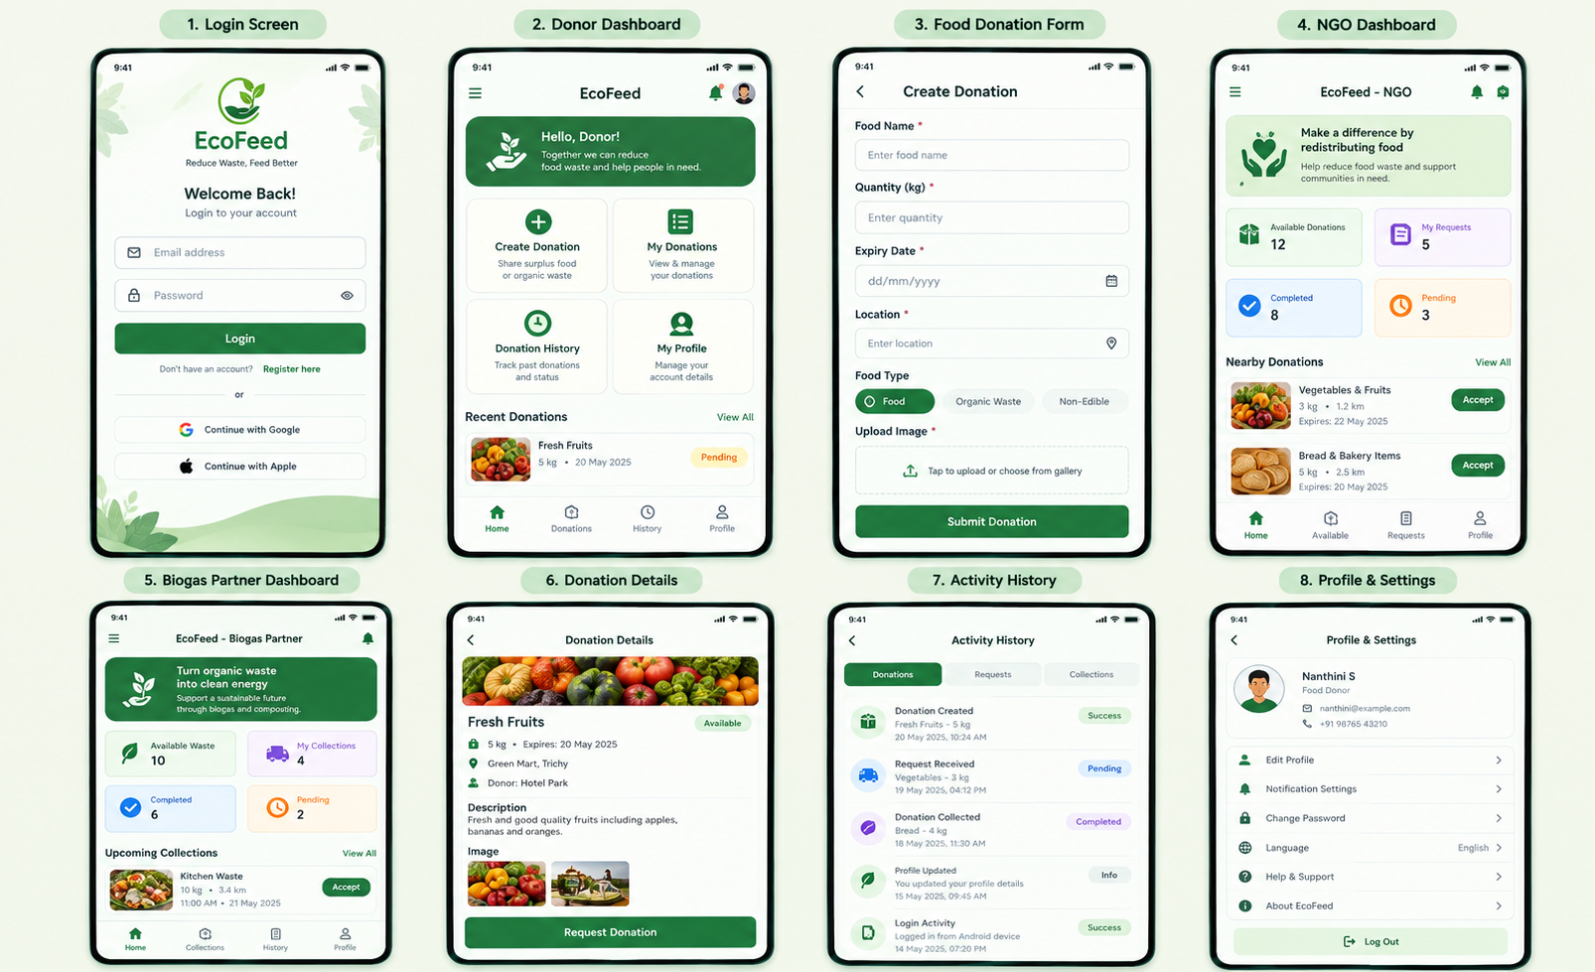
UI PROTOTYPE
,

Slide 17
IMPLEMENTATION DETAILS
Frontend: Kotlin and Jetpack Compose are used to develop the Android application and create a user-friendly interface.
Backend: Supabase provides backend services for managing application data, user authentication, and communication with the database.
Database & Authentication: Supabase PostgreSQL stores donation details, while Supabase Auth manages user login.
Image Storage: Supabase Storage stores food donation images and allows the application to access them.
Role-Based Access: Separate dashboards are provided for donors, NGOs, and biogas partners.
Food Routing: Food expiry status helps route edible food to NGOs and suitable organic waste to biogas partners.
Real-Time Updates: Supabase Realtime supports updates to donation and request information.

Slide 18
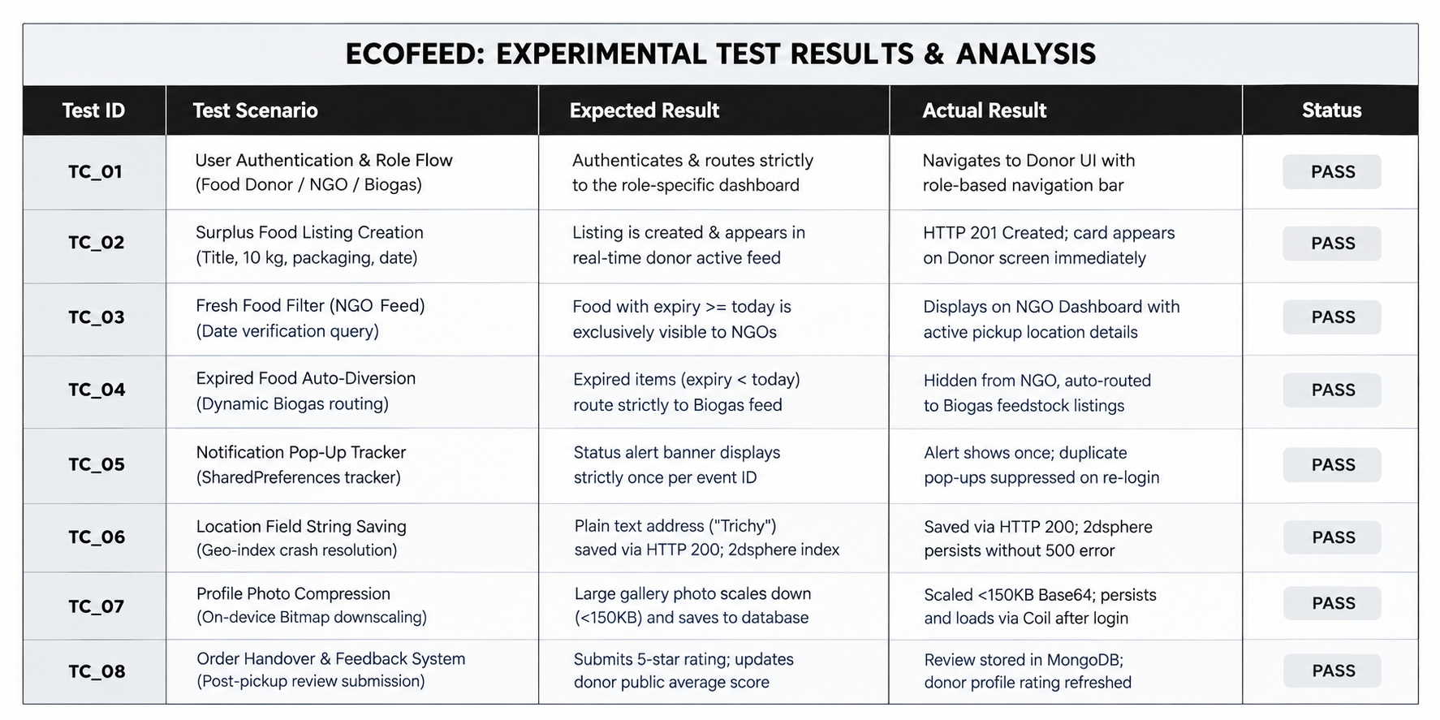
TEST CASES/EXPERIMENTAL ANALYSIS

Slide 19
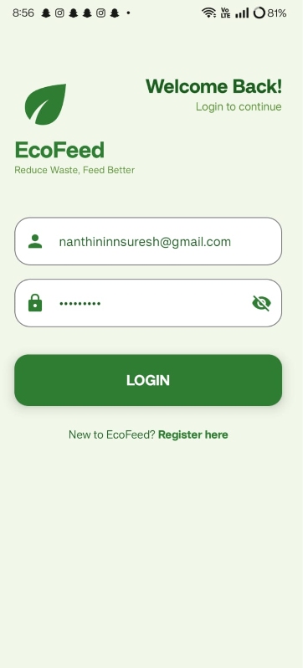
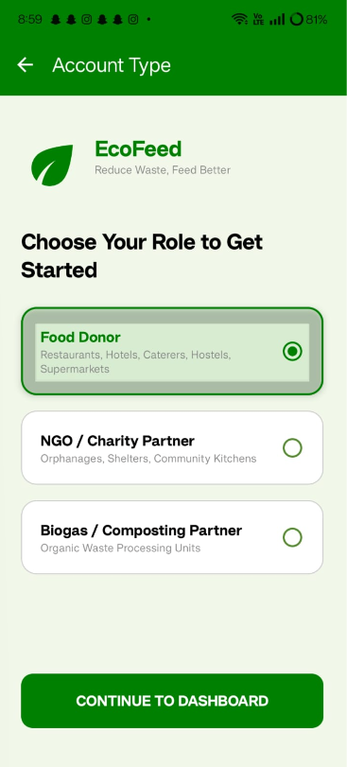
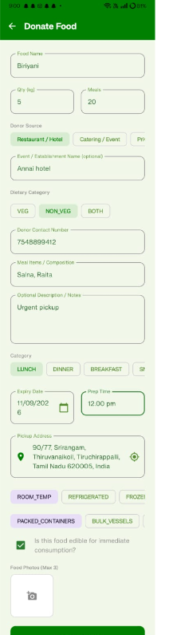
OUTPUT SCREENSHOT

Slide 20
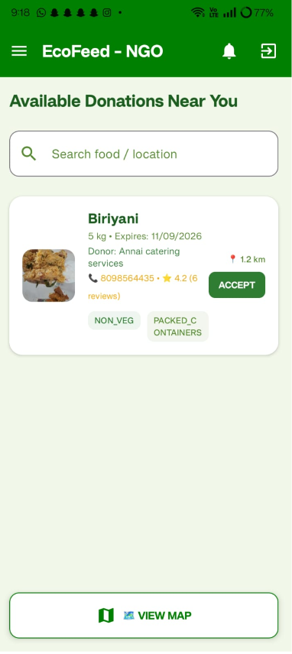
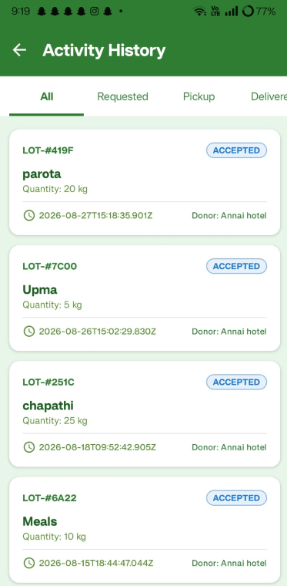
OUTPUT SCREENSHOT

Slide 21
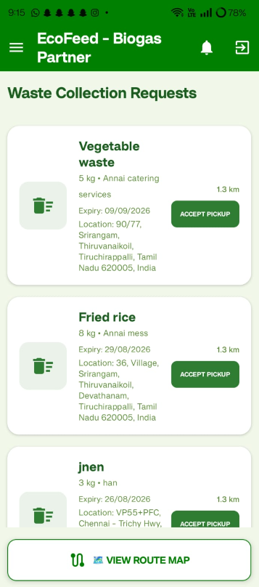
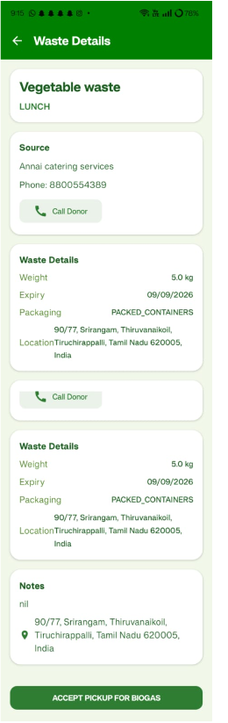
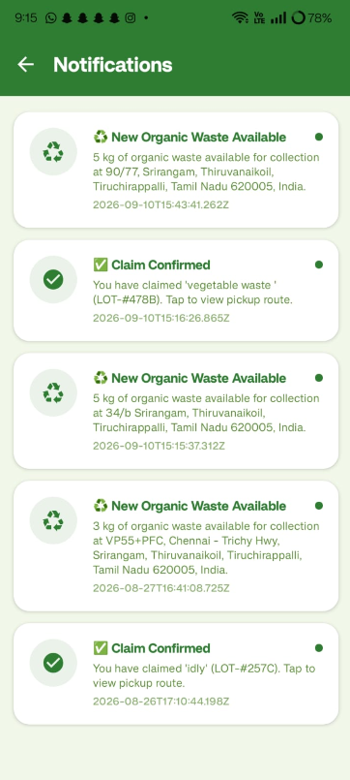
OUTPUT SCREENSHOT
OU

Slide 22
CONCLUSION
EcoFeed is an intelligent and sustainable platform that connects food donors with nearby NGOs and shelters to ensure surplus edible food reaches people in need. The system uses GPS-based matching and expiry-date prioritization for faster and efficient food distribution.Non-edible food and vegetable waste are redirected to biogas or composting partners, helping convert waste into useful resources. By combining food donation, waste recycling, pickup tracking, and digital monitoring in a single platform, EcoFeed reduces food wastage, supports renewable energy generation, and promotes a sustainable circular economy.

Slide 23
REFERENCES
1. Abiad, M. G., & Meho, L. I. (2018). Food loss and food waste research in the Arab world: A systematic review. Food Security, 10, 311–322.
2. Appels, L., Baeyens, J., Degrève, J., & Dewil, R. (2008). Principles and potential of the anaerobic digestion of waste-activated sludge. Progress in Energy and Combustion Science, 34(6), 755–781.
3. Aschemann-Witzel, J., de Hooge, I., Amani, P., Bech-Larsen, T., & Oostindjer, M. (2015). Consumer-related food waste: Causes and potential for action. Sustainability, 7(6), 6457–6477.
4. Beretta, C., Stoessel, F., Baier, U., & Hellweg, S. (2013). Quantifying food losses and the potential for reduction in Switzerland. Waste Management, 33(3), 764–773.
5. Gustavsson, J., Cederberg, C., Sonesson, U., van Otterdijk, R., & Meybeck, A. (2011). Global food losses and food waste: Extent, causes and prevention. Food and Agriculture Organization of the United Nations.

Slide 24
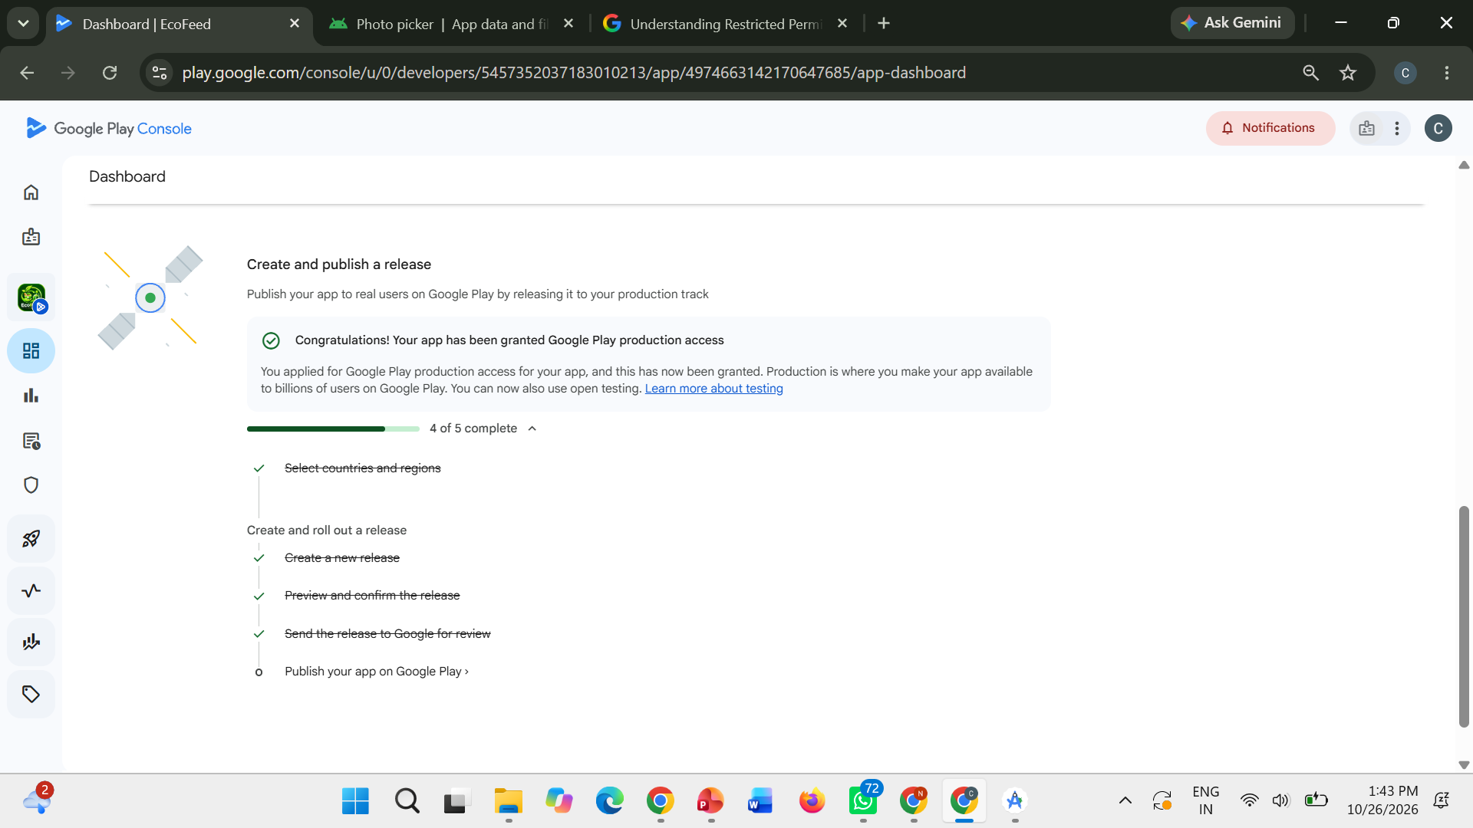
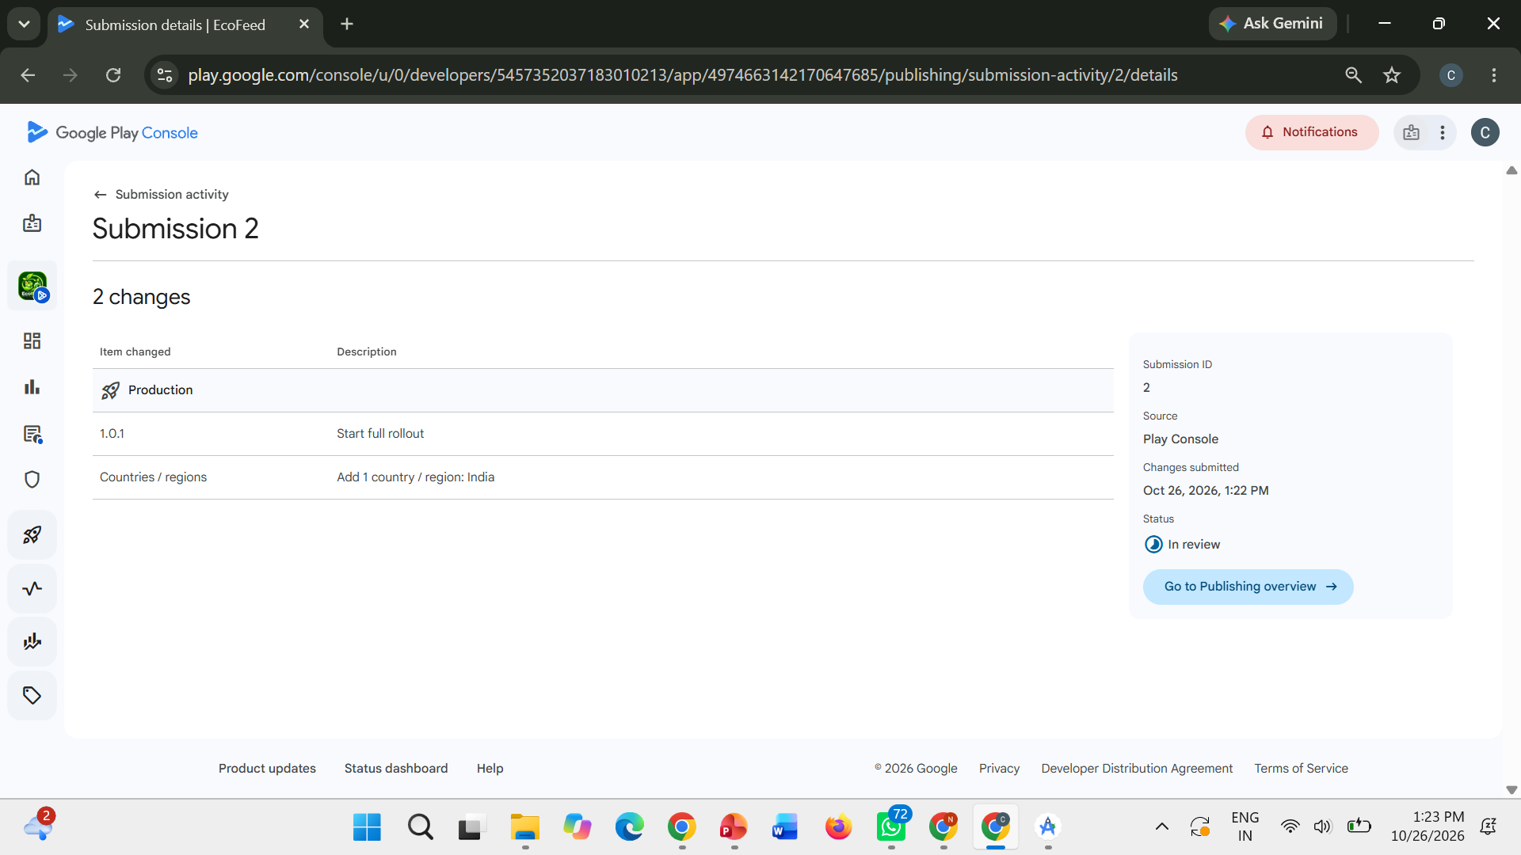
PRODUCT PUBLICATION PROOF

Slide 25
Queries ????

